Slide 1
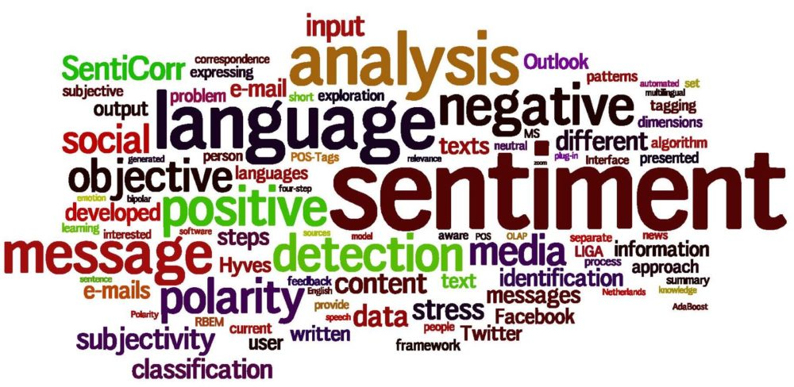
A comprehensive survey on sentiment analysis approaches, challenges and trends
Birjali et.al.
Presentation by
o Divya Khairnar o Siddhesh Pawar o Muhammad Raees

Slide 2
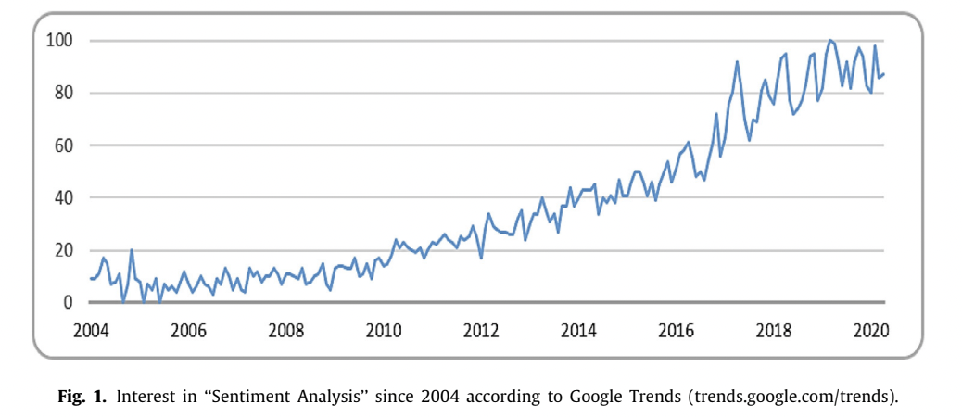
Introduction
Sentiment Analysis is the extracting and analyzing people’s opinions, sentiments, attitudes, perceptions, etc., using natural language processing(NLP) from a body of text.
Sentiment analysis is relevant for daily life and has become popular among companies, governments, and organizations

Slide 3
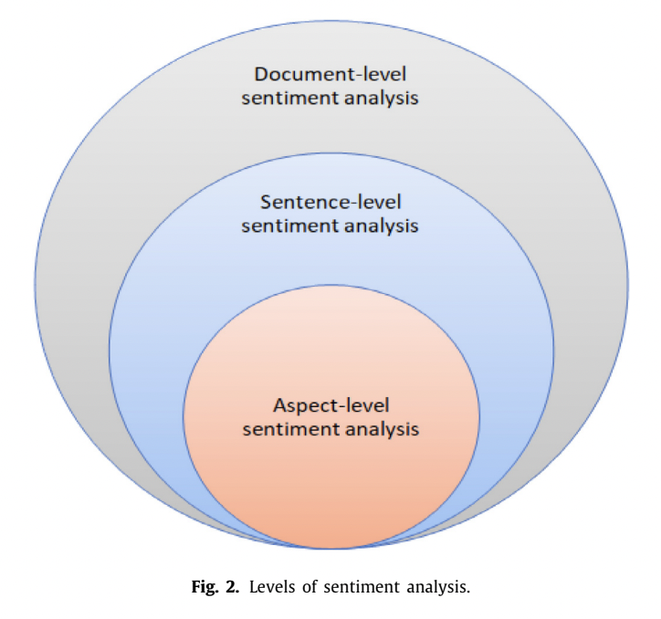
Levels of sentiment analysis

Slide 4
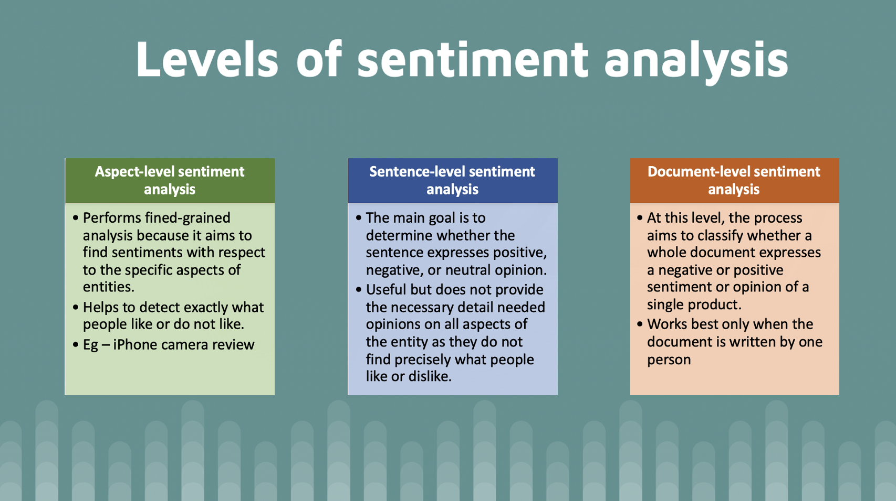

Slide 5
Application Domain
Business intelligence:
Companies can exploit the results of sentiment analysis to make product improvements, study the customer’s feedback, or adopt a new marketing strategy.
Recommendation system:
A recommender system is an algorithm that aims to suggest relevant items (movies, music, or product to buy) to users.

Slide 6
Application Domain
3. Government intelligence:
Using sentiment analysis to identify opinions on government policies or other similar issues is very helpful for monitoring possible public reaction on implementation of certain policies.
4. Healthcare and medical domain:
Sentiment analysis in the medical domain allows healthcare actors to obtain information about the diseases, adverse drug reactions, epidemics, and patients’ mood and analyze them to provide better healthcare services.

Slide 7
Sentiment Analysis Preprocessing
Sentiment analysis involves several NLP tasks that need to be resolved.
The field of Information Retrieval faces unresolved NLP problems like negation handling and sarcasm detection, in addition to other problems like opinion summarization and implicit/explicit features extraction.
The generic sentiment analysis process involves data collection, text processing, features extraction and selection, and classification.

Slide 8
Data Extraction
The first step is to have textual data, which can be obtained from various sources such as Social Media, review websites, weblog, forums, and interview transcripts.
Public datasets, APIs, free available datasets, web scraping, and crowdsourcing can also be used to get data for sentiment analysis.
The development of Web 2.0 has made data available in different formats such as text, images, audio, and video.
Sentiment analysis can make use of this variety to perform sentiment analysis.

Slide 9
Data Pre-processing
Data pre-processing involves cleaning and preprocessing unstructured text data before analysis to reduce dimensionality and noise.
The common tasks in data pre-processing include tokenization, stop words removal, Part-of-Speech (Post) tagging, and lemmatization.
The pre-processing step can differ based on the input data format, and may require additional processing and cleaning steps such as expanding abbreviations and removing repeated characters.
To perform better sentiment analysis, two fundamental steps are needed: feature extraction and feature selection.

Slide 10
Feature Extraction
Feature extraction is a fundamental task in sentiment analysis and directly influences its performance.
The task involves extracting valuable information, such as words that express sentiment, from text.
Dealing with social media texts brings additional challenges, and other features can be incorporated, such as punctuations, emoticons, hashtags, and capital text.
Some important features used in sentiment analysis are terms presence and frequency, parts-of-speech (PoS) tags, opinion words and phrases, and negations.

Slide 11
Feature Extraction
Text representation is necessary to transform input text into a fixed-length feature vector suitable for classification algorithms.
The bag-of-words model (BoW) and the vector space model (VSM) are used for text representation, with BoW being the simplest and most common technique.
Distributed representation, also called word embedding, is a technique used with deep learning models and includes methods like Word2vec and GloVe.

Slide 12
Feature Selection
Feature selection helps to remove irrelevant and redundant features to improve sentiment classification accuracy.
Feature selection methods include lexicon-based and statistical methods.
Lexicon-based approaches involve manually selecting sentiment terms and enriching the feature set with synonyms and online resources.
Statistical approaches are fully automatic and include filter, wrapper, embedded, and hybrid approaches.

Slide 13
Feature Selection
Filter approach is the most common and selects features based on statistical measures without using machine learning algorithms.
Wrapper approach depends on machine learning algorithms and evaluates feature subsets based on algorithm performance.
Embedded approach incorporates feature selection during modeling algorithm execution, using algorithms with built-in feature selection.
Hybrid approach combines different approaches to get the best possible feature subset, achieving high performance and accuracy.

Slide 14
Sentimental Analysis Techniques
Sentiment Analysis is an active research field with many applications in different domains.
Researchers are constantly proposing, evaluating, and comparing different approaches to increase performance and find solutions to challenges.
Approaches can be categorized based on various points of view but are generally divided into three categories: Machine Learning, Lexicon-Based, and Hybrid.
Machine Learning is the most widely used approach and includes supervised, unsupervised, semi-supervised, and reinforcement learning.
Lexicon-Based approaches use sentiment lexicons, which represent a list of words and phrases commonly used to express positive or negative sentiments.
Hybrid approaches combine machine learning and lexicon-based approaches to improve performance.

Slide 15
Sentimental Analysis Techniques
The manual approach and dictionary-based approach are two techniques for creating and annotating sentiment lexicons.
The manual approach requires human intervention to annotate the lexicon, while the dictionary-based approach assumes synonymous words have the same sentiment polarities.
SentiWordNet 3.0 and SO-CAL are two well-known lexicons created using the manual approach.
WordNet and thesauri are two dictionaries used in the dictionary-based approach to create sentiment lexicons.
A combination of both manual and automated approaches can be used to speed up the creation of sentiment lexicons. Crowdsourcing and gamification are two methods used for this purpose.

Slide 16
Sentimental Analysis Techniques
The hybrid approach utilizes the high accuracy of machine learning and the stability of lexicon-based approaches.
Sentiment lexica play an important role in the hybrid approach, and it is usually known to achieve higher performance.
Only a few models utilize the hybrid approach for sentiment analysis; most of them use lexicon-based approaches.
Some works have combined machine learning classifiers with dictionaries and lexicons for sentiment analysis.
Deep learning can also be combined with lexicons for sentiment analysis. For instance, lexicon embeddings and an attention mechanism were integrated into a convolutional neural network model to improve accuracy, stability, and efficiency

Slide 17
Challenges
Sarcasm Detection
Negation Handling
Word Sense Disambiguation
Low-Resource Languages
Code-mix Data
Spam Detection
Anaphora and Conference Resolution

Slide 18
Sarcasm
Sarcasm and irony are commonly used, but they can be difficult to detect and interpret in sentiment analysis.
Sarcasm and irony often reverse of sentiment polarity.
"Oh great, another meeting. Just what I needed today."
"Thanks for the gift card to my favorite restaurant, which closed down last month."
"That's just what I love, another project during my vacation."

Slide 19
Sarcasm
Various approaches are used to overcome sarcasm and irony.
Contextual information
LSTM models and CNNs are used to learn the semantic context.
Linguistic cues
Contrastive markers (but, however, although)
Intensifiers (absolutely, kind of)
Irony markers (Yeah, right). Emoticons, punctuations etc.
However, it is still an active area of research, and more sophisticated models and techniques for handling these forms of language are needed.

Slide 20
Negation
Negation words such as not, neither, nor, etc. also reverse the polarity of a given text.
‘‘This movie is good.’’
‘‘The movie is not good.’’
In some approaches, negation are as Stop-Word lists or ignored implicitly having a neutral sentiment.
Reversing the polarity is often not suitable because negation words can be found in a sentence without influencing the sentiment of the text.
“We will not only party, we will play games too”
Again, LSTM and CNN could be helpful to find negation dependencies.

Slide 21
Word Sense Disambiguation
Word sense disambiguation (WSD) is the process of determining the correct meaning of a word with multiple meanings in a context.
“I need to book a flight to Rome."
"The batter left the ball because it was thrown to his left."
Methods proposed to solve WSD by using Latent Semantic Analysis (LSA) with contextual information.
In a similar way, word polarity disambiguation (WPD) is another challenging problem. WPD aims to resolve polarity of the sentiment-ambiguous words in a specific context.

Slide 22
Low-resource languages
Linguistic resources are costly to obtain for unpopular languages.
Methods to overcome this problem:
Constructing linguistic resource from scratch
Using unsupervised, semi-supervised and transfer learning approaches e.g., exploit the rich English resources for Chinese sentiment classification.
Cross-lingual approaches have been found useful.
These methods help to increase labeled instances, thus more training data for low-resource languages.

Slide 23
Code-Mix Data
Code-Mixing (CM) is the use of vocabulary and syntax from multiples languages in the same sentence.
Lack of a formal grammar.
Mixing is up to the person - there are no mixing rules.
Some models explored code-mixed Hinglish (Hindi–English language pair) text.
Identifying switching points (where the person switches to another language).
Proposing a hybrid architecture for English–Hindi code-mixed data.

Slide 24
Other challenges
Spam
Spam (e.g., fake reviews) can damage the authenticity of the information.
Brands artificially manipulate users’ to buy products/services.
Anaphora - relation of coreference between linguistic terms
E.g., what a pronoun refers to in a sentence helps to extract all the aspects of a given entity.
Pronouns are usually removed in the preprocessing step.
Some algorithm provide anaphora resolutions by uncovering compound nouns and the PoS.

Slide 25
Conclusion
This paper presents an overview of sentiment analysis and its related approaches.
Levels and sub-tasks
Process - pre-processing, feature extraction and selection.
Sentiment classification techniques - ML, lexicon, others
Challenges - open research areas.
Other languages than English have gained more interest, recently.
Overall, a factual paper. Limited in terms of insights.

Slide 26
Questions ?
Thank You

